Slide 1
Wealth Management Mobile App
Functional Requirements:
The mobile application will create a direct communication between Clients and their managers.
Every Client must have this app installed on a mobile device.
Every Client must be registered with the Wealth Management Firm.

Slide 2
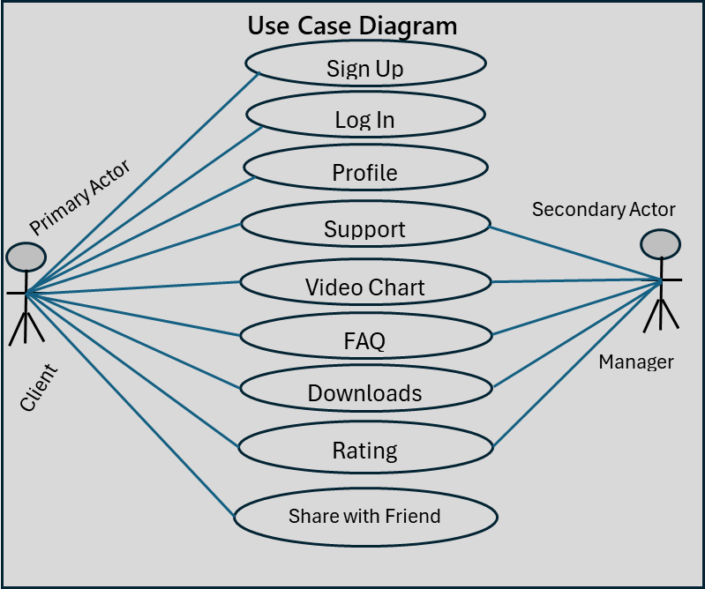
Use Case Diagram

Slide 3
Product Backlog
This contains the functionalities involved in the building of the wealth management mobile application and the user stories associated with each of the functionality.

Slide 4
1.0. Sign Up
1.1. As a client, I want to be able to fill a form when I click on 'Sign Up' button, So that I can register on the WIN Mobile App
Acceptance Criteria: GIVEN that I open the WIN Mobile App on my mobile phone, WHEN I see and click on 'Sign Up' button,
THEN, I am able to fill a registration form for the WIN Mobile App.
1.2. As a client, want to see and click 'Sign Up' and 'Cancel' buttons when through with form filling,
So that I can sign up or cancel my registration
Acceptance Criteria: GIVEN that I open the WIN Mobile App on my mobile phone, WHEN I'm done with form filling,
THEN I'm able to see 'Sign Up' and Cancel' buttons so that I can click on either of them if case be
1.3. As a client, I want to see 'Confirm your Registration' message from my email, So that I'm able to click on it to confirm my registration.
Acceptance Criteria: GIVEN that I have successfully filled the registration form on the WIN Mobile App, WHEN I check my registered email,
THEN I'm able to see 'Confirm your Registration' message.
1.4. As a client, I want to be taken to my login page when I click on the 'Confirm your Registration' messsage from my email,
So that I can complete my registration on the WIN Mobile App.
Acceptance Criteria: GIVEN that I successfully filled the registration form on the WIN Mobile App.
WHEN I click on the 'Complete your Registration' from my registered email, THEN I'm able to access my login page.

Slide 5
2.0. Login
2.1. As a client, I want to see 'email' and 'password' typing bars, SO that I' able to enter my emal and password.
Acceptance Criteria: Given that I'm on the login page of the WIN mobile app, When I see 'email' and 'password' typing bars,
Then I'm able to enter my email and password
2.2. As a client, I want to see 'Log in' button on the login page, So that I can click on it to Sign in to my WIN mobile app.
Acceptance Criteria: Given that I'm logged in on the WIN mobile app, When I see 'Log in' button on the login page,
Then I can click on it to sign in to my account.
2.3. As a client, I want to see 'Forgot Password' tab on my login page, So that I can click on it and have the option
of getting a new password.
Acceptance Criteria: Given that I'm logged in on the WIN mobile app, When I see 'Forgot Password' tab on the login page,
Then I am able to click on it for a new one.

Slide 6
3.0. Profile
3.1. As a client, I want to see profile form displayed When I click on :Profile' tab , So that I can fill in my details on the form.
Acceptance Criteria: Given that I'm logged in to the WIN mobile App, When I see 'Profile' tab and click on it,
Then I'm able to fill in my deya/from the form that displays.
3.2. As a client, I want to see 'Save' and 'Clear' tabs at the bottom of the 'profile form' from the 'Profile' tab,
So that I'm able to save or clear the details on the form.
Acceptance Criteria: Given that I'm logged into the WIN mobile App, When I see and click on 'Save' or 'Clear',
Then I'm able to save the profile I created or just clear it.
3.3. As a client, I want to see 'Edit Profile' tab from the Profile page, So that I can modify my profile if needs arise.
Acceptance Criteria: Given that I'm logged into the WIN mobile App, When I see and click on 'Edit Profile',
Then I'm able to make changes to my already created profile.
3.4. As a client, I want to see 'Log out' tab from the Profile page, So that when I click on it,
I will be asked if I want to logout with 'Yes' and 'No' options to choose from.
Acceptance Criteria: Given that I'm logged in to the WIN mobile App, When I see and click on 'Logout' from the Profile page,
Then I will be asked with a 'Yes' and 'No' options if I wanted to logout.

Slide 7
4.0. Complaints 4.1. As a client, I want to have the option of typing and sending instant message to the online manager when I click on 'Complaints' tab,
So that I'm able to lodge a complain or seek for a specific answer.
Acceptance Criteria: Given that I'm logged into the WIN mobile App, When I click on 'Complaints' tab and have access to typing
and sending instant message to the manager, Then I'm able to lodge a complain or seek certain clarifications.
4.2. As a client, I want to be able to receive instant message from the manager few seconds after sending mine,
So that I can get the necessary clarifications to a complain made.
Acceptance Criteria: Given that I'm logged into the WIN mobile App, When I have the ability to see instant reply to my sent message
few seconds after sending, Then I can receive responses to my complaints.
4.3.As a client, I want to see 'Send File' on the 'Complaints' tab, So that I'm able to send files/attachments to the online manager.
Acceptance Criteria: Given that I'm logged into the WIN mobile app and clicked on th 'Complaints' tab, When I see 'Send File' tab,
Then I can send files/attachment to the manager if there be a need.
4.4. As a client, I want to have multiple file locations options when I click on 'Send File' tab, So that I can make my selection.
Acceptance Criteria: Given that I'm logged into the WIN mobile app and clicked on 'Send File' tab, When I see multiple file locations
options (device, drop box, cloud, Google Drive), Then I can make my selection.
4.5. A a client, I want to have multiple file format options when I click on 'Send File' tab, So that I can make my selection.
Acceptance Criteria: Given that I'm logged into the WIN mobile app and clicked on 'Send File' tab, When I see multiple file formats
options (doc, xlsx, pdf, txt, etc), Then I can make my selection.

Slide 8
4.0. Complaints Contnd…
4.6. As a manager, I want to be logged into the manager's portal of the WIN mobile App
So that I can see and send immediate replies to the client's instant messages.
Acceptance Criteria: Given that I'm logged into the manager's portal of the WIN mobile App, When I see the client's instant messages,
Then I'm able to reply them immediately.
4.7 As a manager, I want to have multiple file formats options on my device, So that I can have access to the client's files and attachments.
Acceptance Criteria: Given that I'm logged into the manager's portal of the WIN mobile App, and having instant messaging with the
client, When I have multiple file formats options on my device (doc, xlsx, pdf, txt, etc), Then I can have access to the client's files/attachments.
4.8. As a client, I want to have the ability to give a feedback or review, So that I can give a review or feedback on my messaging experience with the manager.
Acceptance Criteria: Given that I'm logged into the WIN mobile App and clicked on 'Complaints' tab, When I see the option to give a review or feedback,
Then I can give a feedback on my messaging experiences with the manager.
4.9. As a manager, I want to log into the manager's portal of the WIN mobile App, So that I can send a review platform to the client.
Acceptance Criteria: Given that I'm logged into the manager's portal of the WIN mobile App, When I'm done with the instant messaging with the client,.
Then I can send the client a review platform so as to give feedback.
4.10. As a client, I want to have options to either do the review after instant messaging with the manager or skip, So that I can decide to give my reviews or don't.
Acceptance Criteria: Given that I'm logged into the WIN mobile App, clicked on 'Complaints' tab, and just finished instant messaging with the manager,
When I see 'Skip Review' tab at the bottom of the review page, Then I can either type the review and send or click on 'Skip Review' so as not to do the review.
4.11. As a client, I want to have options of various social media handles and contact information of the firm when I click on 'Complaints' tab,
So that I can make use of them when necessary.
Acceptance Criteria: Given that I'm logged into the WIN mobile App and clicked on 'Complaints' tab, When I have access to
various social media handles and contact information of the organization, Then I can make use of them when needed.

Slide 9
5.0. Video Chart
5.1. As a client, I want to see 'Check Availability' when I click on 'Video Chart' tab from my WIN mobile app, So that I can click on it
to check if an online agent/manager is available to speak with me.
Acceptance Criteria: Given that I'm logged into the WIN mobile app, When I see and click on 'Check Availability', Then I can check if an agent/manager
is available to speak with me through video call.
5.2. As a client, I want to see messages, 'An Agent will speak with you shortly' or 'Sorry. No one is available at the moment' appear on my screen,
So that I can know if the video chart will be possible or not.
Acceptance Criteria: Given that I'm logged into the WIN mobile app, When I see and click on 'Check Availability',
Then I can see messages, 'An Agent will speak with you shortly' or 'Sorry. No one is available at the moment' appear on my screen,
5.3. As a client, I want to see a follow up message, 'Would you want to wait for some time or check back later?' from the,
Sorry. No one is available at the moment' message that appeared when I cliicked 'Check Availability' from the 'Video Chart' tab,
So that I can decide what to do.
Acceptance Criteria: Given that I logged into the WIN mobile app and clicked on the 'Video Chart' tab, When I see a message,
Would you want to wait for some time or check back later?' which was a follow up message to the, 'Sorry. No one is available at the moment',
message that appeared when I clicked on the 'Check Availability' tab, Then I will know what decision to take.
5.4. As a client, I want to see 'Wait' and 'Check Later' buttons, which were from he message, ''Would you want to wait for some time or check back later?',
So that I can either wait or check back later.
Acceptance Criteria: GIVEN that I logged into the WIN mobile app, clicked on 'Video Chart' tab, WHEN I see 'Wait' and 'Check back later' buttons,
which were from the, 'Would you want to wait for some time or check back later?', a follow up message from the, 'Sorry. No one is available at the moment',
a message that appeared when I clicked on the 'Check Availability' tab, THEN I'm able wait for someone to speak with me on the video chart or check back later.
5.5. As a manager, I want to be logged in to the manager's portal of the WIN mobile app, So that I'm availablee to have a video chart with the client.

Slide 10
6.0. FAQ
6.1. As a client, I want to see 'FAQ' tab when I'm logged into the WIN mobile app, So that I can click on it to explore frequently asked questions.
Acceptance Criteria: Given that I'm logged into ihe WIN mobile app, When I see and click on 'FAQ' tab, Then I can access frequently asked questions.
6.2. As a manager, I want to log in to the manager's portal of the WIN mobile app, So that I can make available frequently asked questions and their answers.
Acceptance Criteria: Given that I'm logged into the manager's portal of the WIN mobile app,When make available some frequently asked questions and their
corresponding answers, Then the client will be able explore them.

Slide 11
7.0. Downloads
7.1. As a client, I want to see 'Downloads' tab when I log into my WIN mobile app, So that I can click on it and check if there are downloads for me.
Acceptance Criteria: Given that I'm logged into the WIN mobile app, When I see and click on 'Downloads' tab, Then I can check if there are downloads for me.
7.2. As a manager, I want to log in to the manager's portal of the WIN mobile app, So that I can upload files for downloads to clients.
Acceptance Criteria: Given that I'm logged into the manager's portal of the WIN mobile app, When I have access clients' ID, Then I can send files for
downloads to clients.

Slide 12
8.0. Rating
8.1. As a client, I would like to see 'Rating' tab on the WIN mobile app, So that I can rate my experiences with the app.
Acceptance Criteria: Given that I'm logged into the WIN mobile app, When I see and click on 'Rating' tab, Then I'm able
to rate my experiences with the app.
8.2. As a client, I want to see rating scales when I click on 'Rating' tab, So that I can choose my scale.
Acceptance Criteria: Given that I'm logged into the WIN mobile app and clicked on 'Rating' tab, When I see rating scales (say 1-5),
Then I can select my rating scale to rate my experience with the app.

Slide 13
9.0. Share with Friend
9.1. As a client, I want to see 'Share with a Friend' tab, So that I will have the ability to share the app with my friends.
Acceptance Criteria: Given that I'm logged into the WIN mobile app, When I see and click on 'Share with a Friend' tab, Then I can share
the app with my friends
9.2. As a client, I want to see various social media handles when I click on 'Share with a Friend' tab, So that I can choose which to share the app with.
Acceptance Criteria: Given that I'm logged into the WIN mobile app and clicked on 'Share with a Friend' tab, When I see various social media
handles, Then I can select which to share the app with.

